Slide 1
Enlighten Lives………..

Slide 2
Social Entrepreneurship
Definition
Social entrepreneurship is the process by which individuals, start-ups and entrepreneurs develop and fund solutions that directly address social issues.

Slide 3
What We Are Doing
Jagriti has 15 Schools in Jaipur and 3 Schools in Ajmer, as many as 5455 underprivileged kids are getting value based education absolutely free of cost. With our limited resources and funds, we ensure that our kids always get the best education. Our intention is that "the kids should not get the feeling that they are inferior by any means and that they are at par with any of the public school"
©copyrightjagriti2020

Slide 4
No | School Name | Date of Adoption | Strength @ adoption | Strength @ 30.9.2023 | %age increase
1 | Jagriti Gyan Vidhya Mandir, Sanganer | 1.10.11 | 40 | 374 | 835
2 | Mahatma Gandhi Government School, Badarwas | 1.7.13 | 52 | 187 | 260
3 | Jagriti Balika Sadan, C-Scheme | 20.2.14 | 0 | 203 | 100
4 | Mahatma Gandhi Government School, Jhalana | 24.7.14 | 55 | 239 | 335
5 | Govt Girls Upper Primary School, Sahkar Marg | 24.7.14 | 52 | 159 | 206
6 | Govt Primary School, Lalarpura | 15.5.15 | 50 | 94 | 88
7 | Govt Girls Sr Sec School, Jagannathpura | 15.5.15 | 50 | 221 | 342
8 | Govt Sr Secondary School, Santosh Nagar | 15.5.15 | 80 | 433 | 441
9 | Govt Sr Secondary School, Girdharipura | 15.5.15 | 110 | 654 | 495
10 | Mahatma Gandhi Government School, Sanjay Nagar | 5.7.16 | 400 | 495 | 24
11 | Govt Sr Secondary School, Sushilpura | 5.7.16 | 360 | 780 | 117
12 | Govt Upper Primary School, Arjunlal Sethi Colony, Ajmer | 11.1.17 | 154 | 250 | 62
13 | Govt Sr Secondary School, Hathroi | 3.2.17 | 262 | 374 | 43
14 | Govt Upper Primary School, Topdara, Ajmer | 13.4.17 | 85 | 115 | 35
15 | Govt Primary School, Hathikheda, Ajmer | 6.7.18 | 75 | 161 | 115
16 | Govt Sr Secondary School, Jaisinghpura | 14.9.20 | 356 | 508 | 43
17 | Jagriti Balwadi School, Bhankrota | 14.10.20 | 0 | 29 | 100
18 | Govt Girls Sr Secondary School, C-Scheme | 14.10.21 | 179 | 179 | 0
Grand Total |  |  | 2360 | 5455 | 131

Slide 5
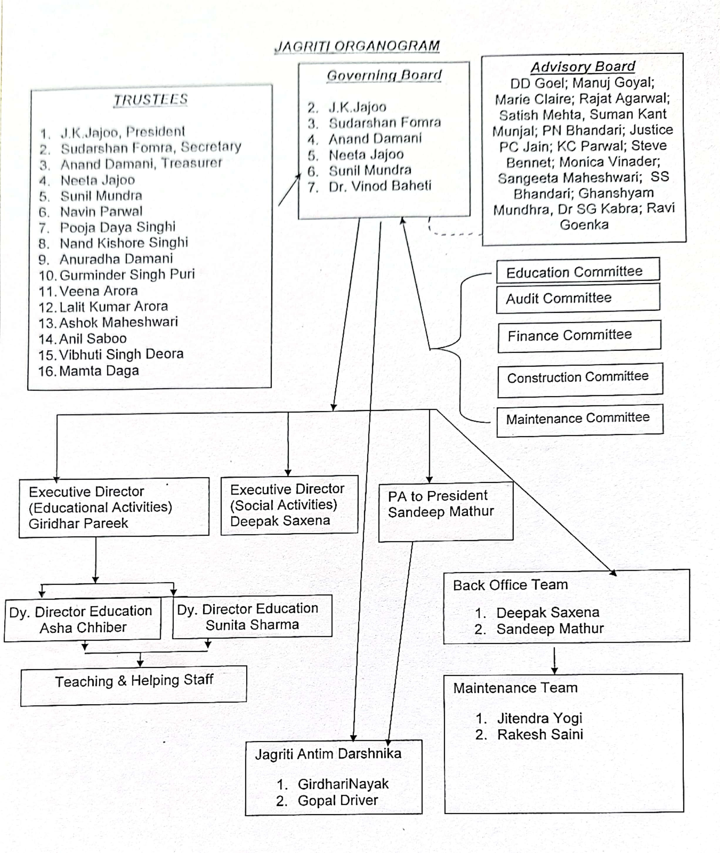

Slide 6
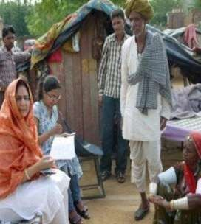
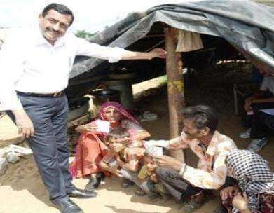
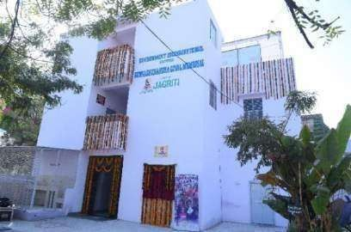
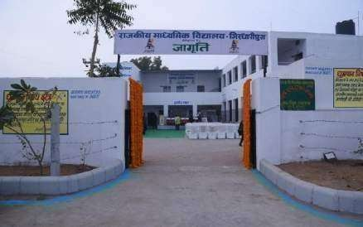
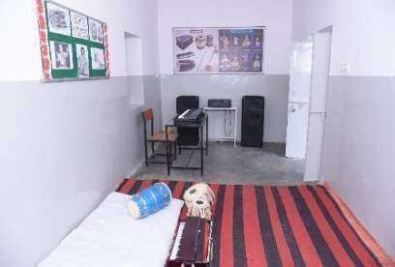
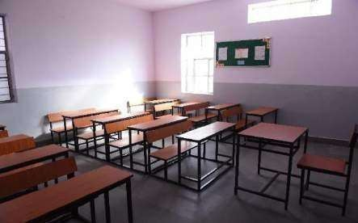
How We are Doing
Enroll
Adopt
Build
Operate (Day to day functioning of the school)
©copyrightjagriti2020

Slide 7
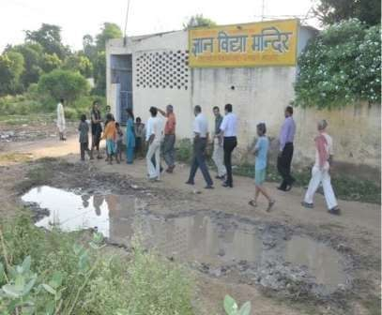
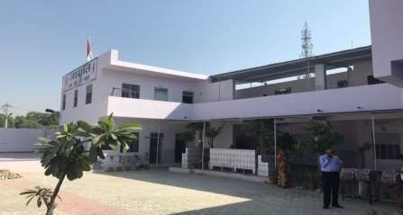
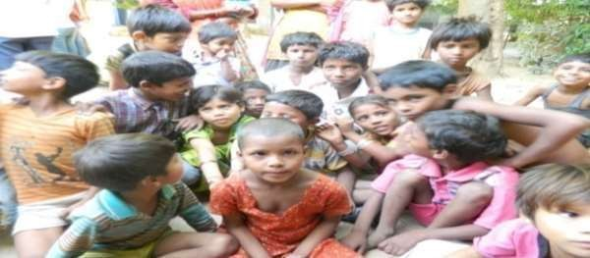
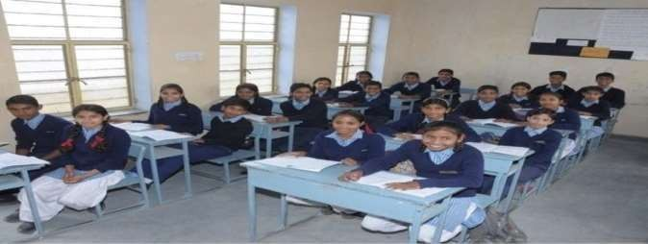
1. Jagriti Gyan Vidya Mandir School, Sanganer
Before Adoption After Adoption

Slide 8
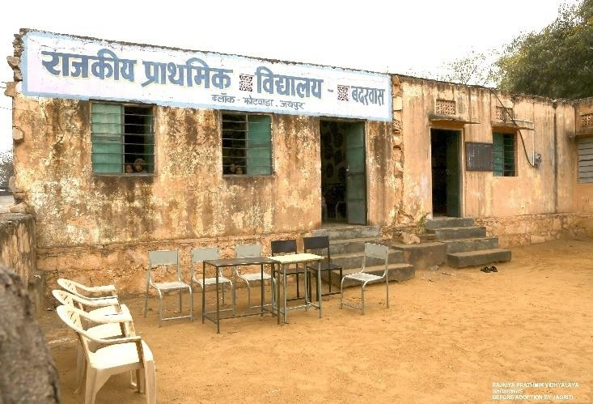
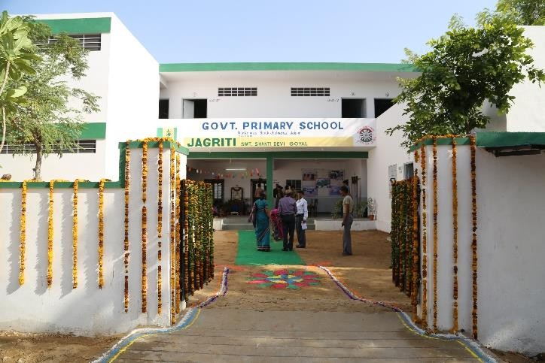
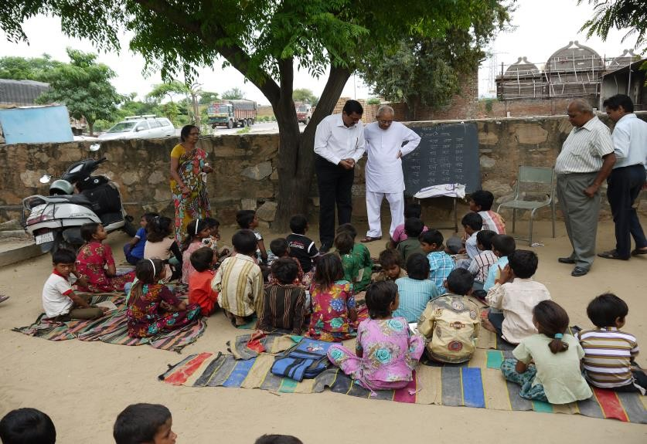
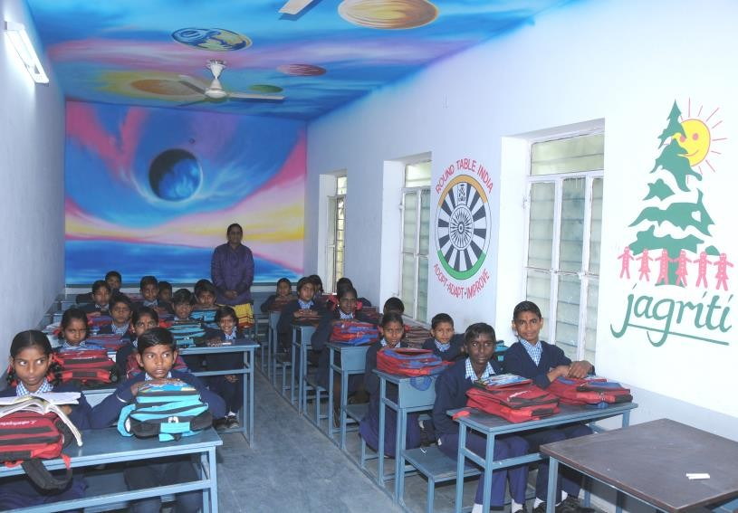
2. JAGRITI Adopted Govt. Primary School, Badarwas
Before Adoption After Adoption

Slide 9
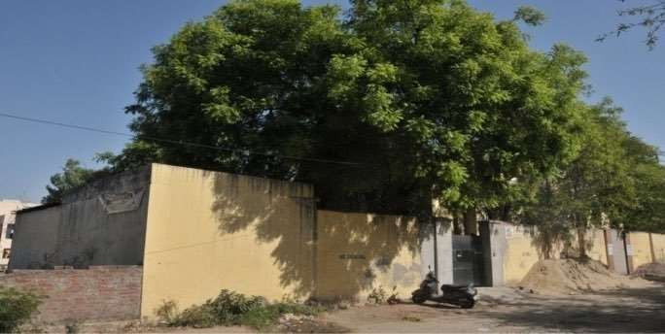
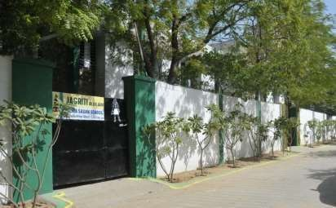
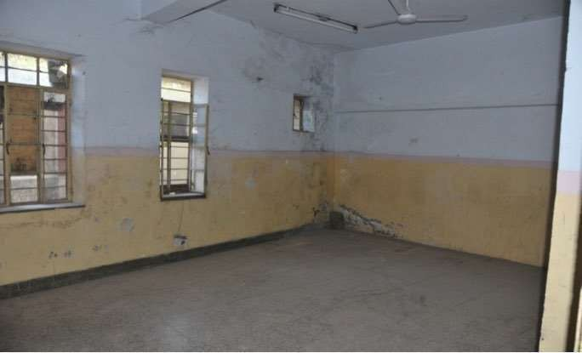
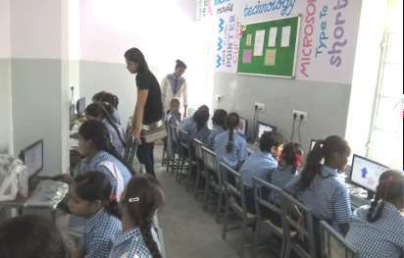
3. Balika Sadan School, C Scheme
Before Adoption
After Adoption

Slide 10
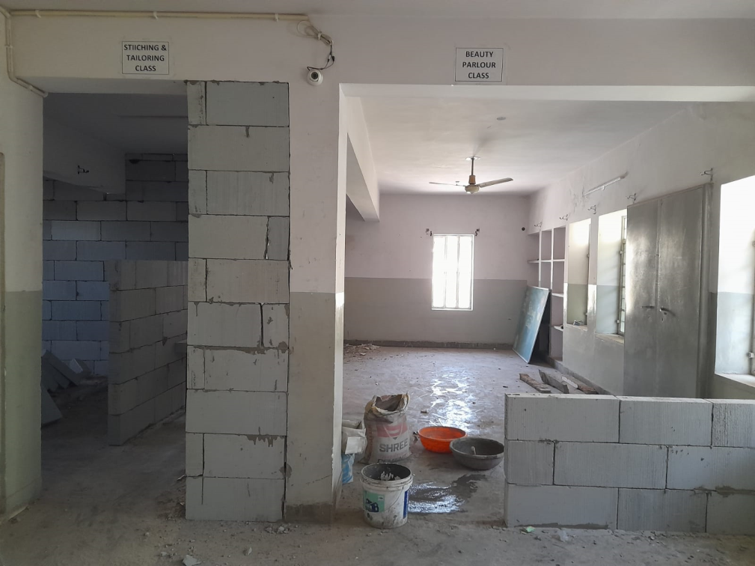
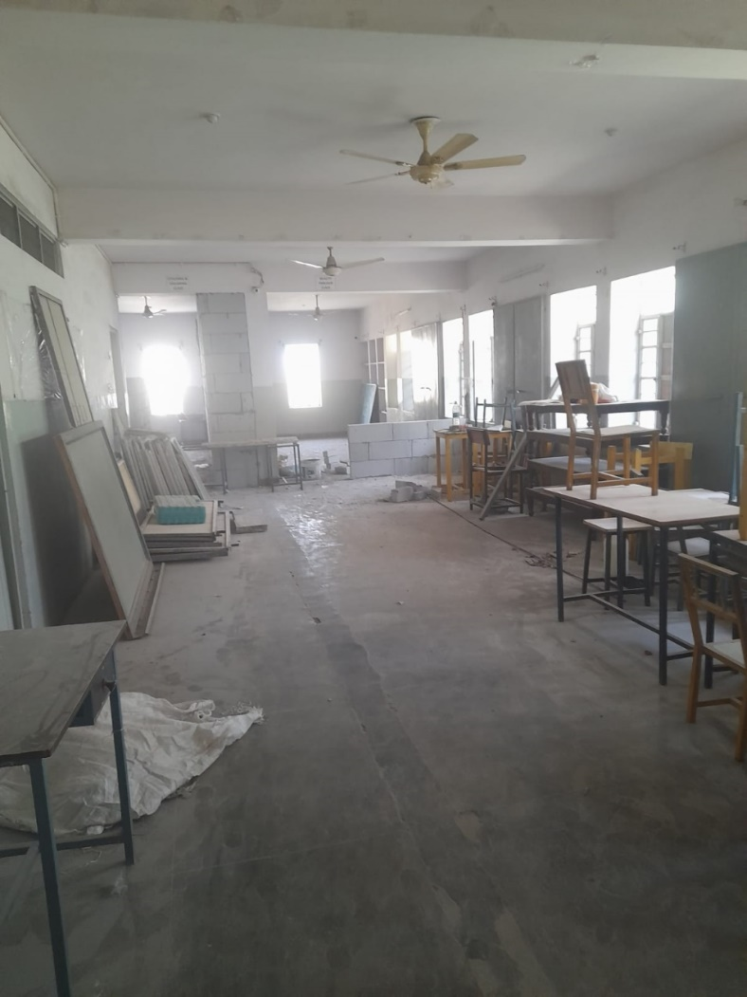
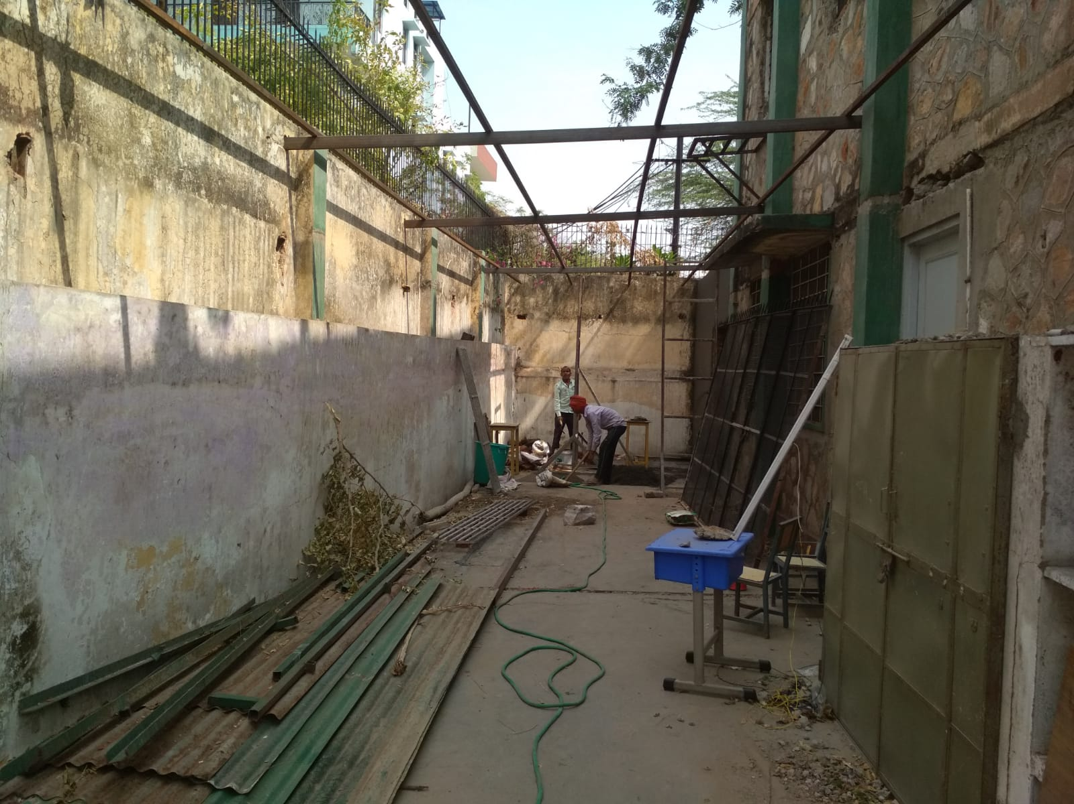
Renovation being done

Slide 11
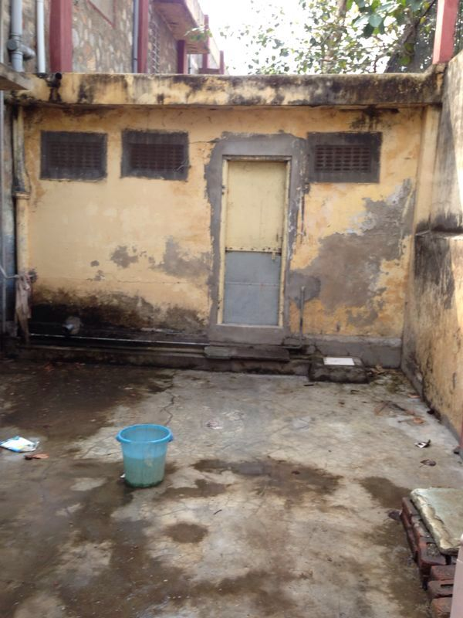
Jagriti Balika Sadan School
Girls Toilet Now
Girls Toilet Then

Slide 12
Jagriti Balika Sadan School
First Floor Abandoned area
Well ventilated Spacious Class Room

Slide 13
Jagriti Balika Sadan School
First Floor Hall Now
First Floor Hall Then

Slide 14
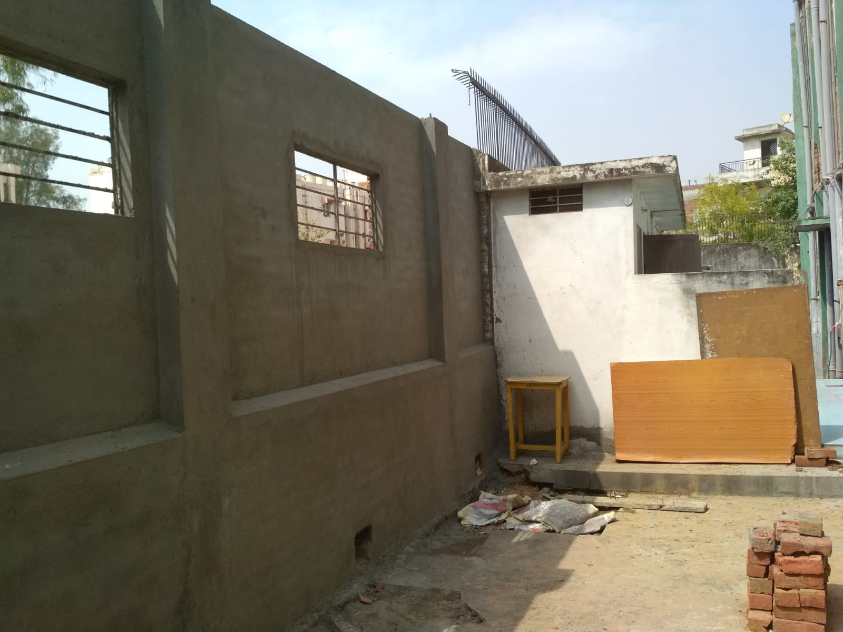
Jagriti Balika Sadan School
The backyard corridor, almost in abandoned condition
The Vocational Centre
(Furniture stacked here)

Slide 15
Jagriti Balika Sadan School
Cracked wall on the back side
Perfect wall on the back side

Slide 16
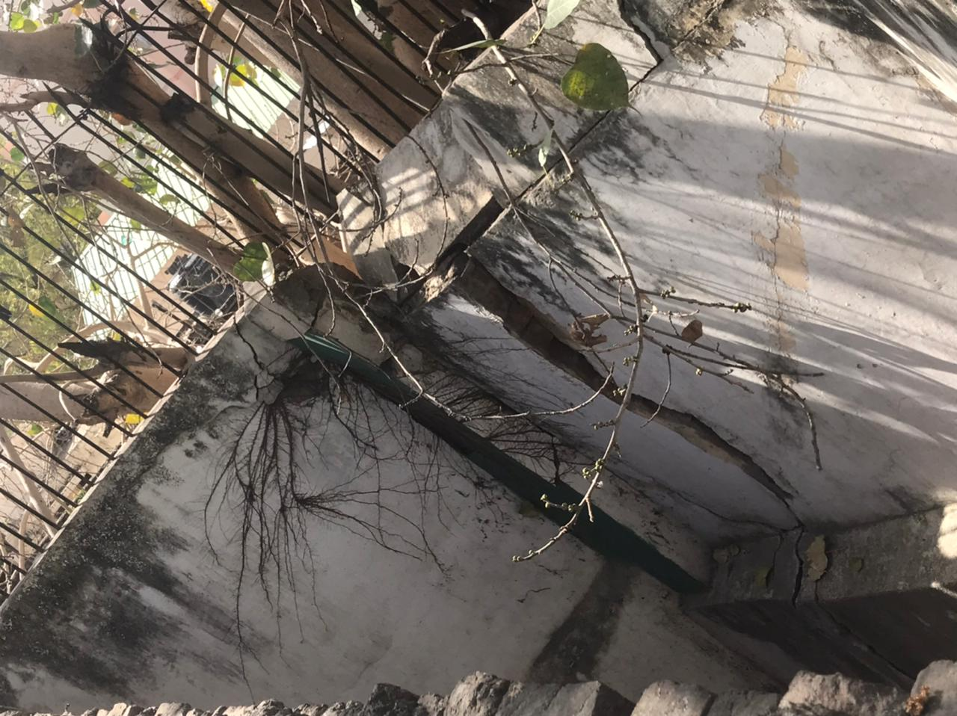
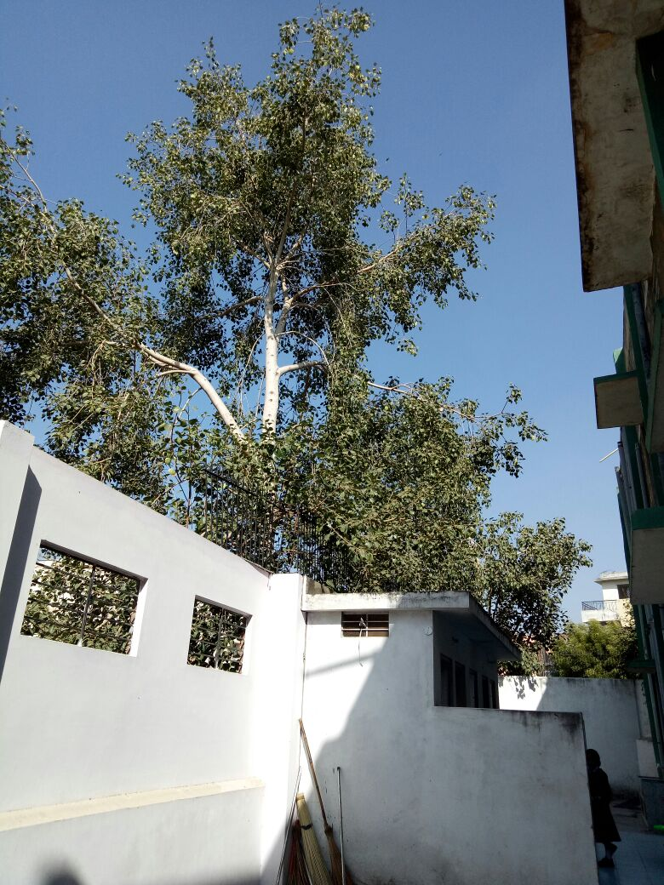
Tree removal

Slide 17
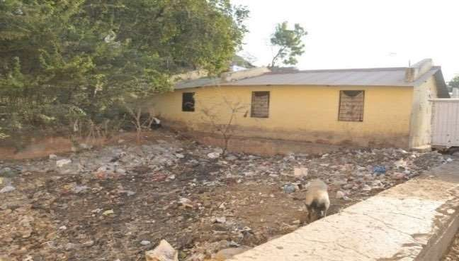
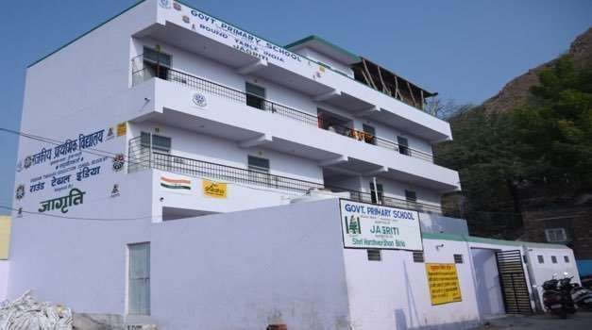
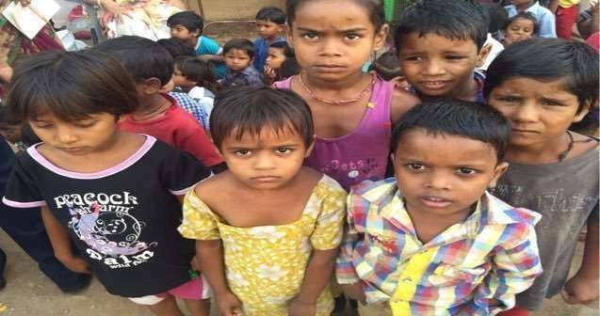
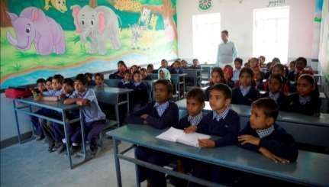
4. Government Primary School, Jhalana
Before Adoption After Adoption

Slide 18
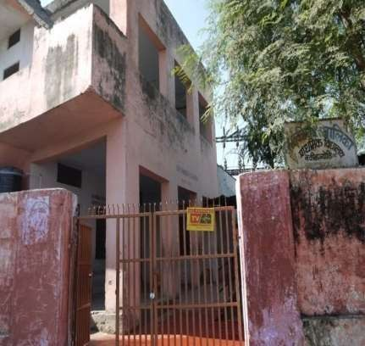
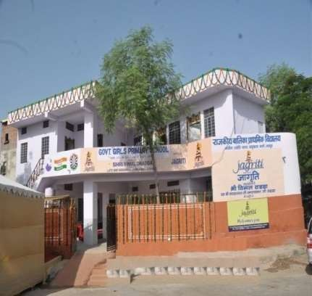
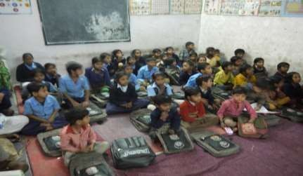
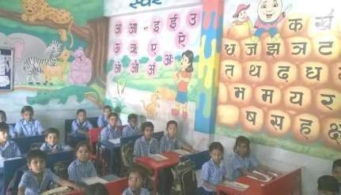
5. Government Primary School, Sahkar Marg
Before Adoption After Adoption

Slide 19
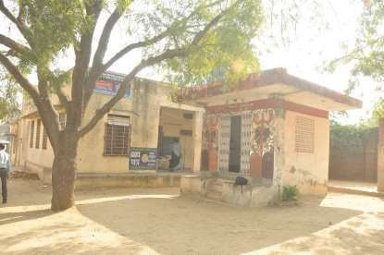
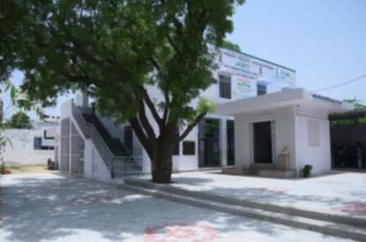
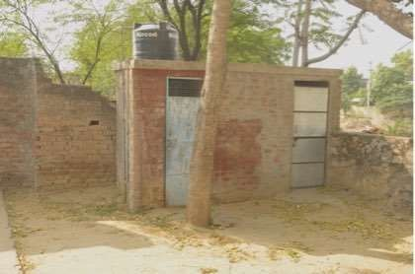
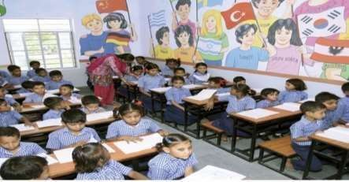
6. Government Upper Primary School Khatipura
Before Adoption
After Adoption

Slide 20
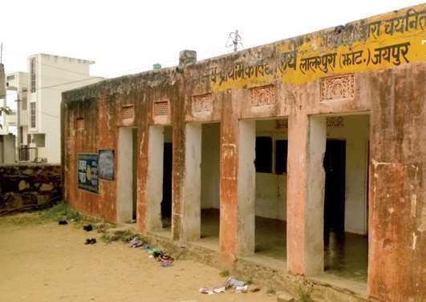
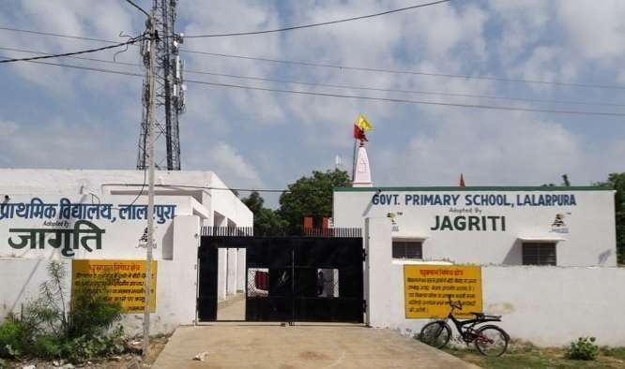
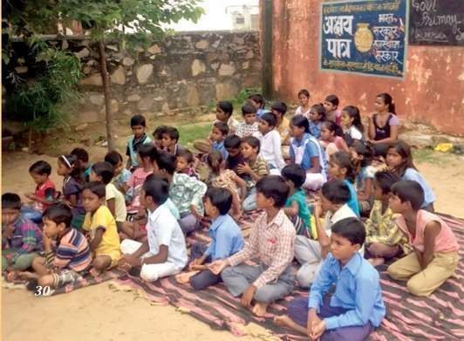
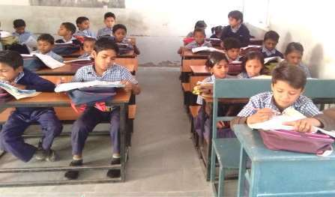
7. Government Primary School, Laalarpura
Before Adoption After Adoption

Slide 21
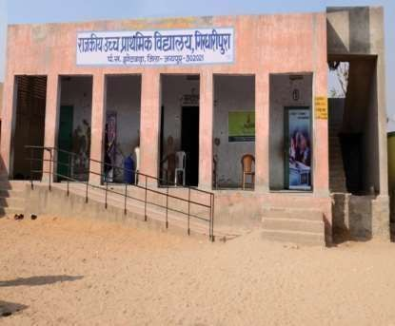
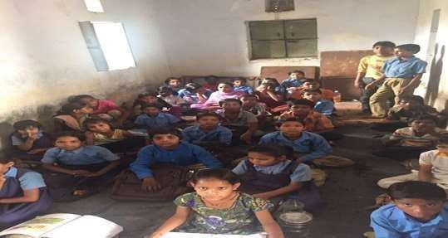
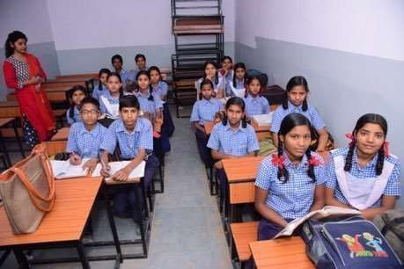
8. Government Upper Primary School, Girdharipura
Before Adoption
After Adoption

Slide 22
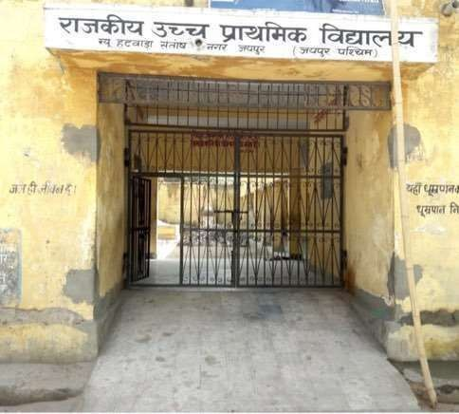
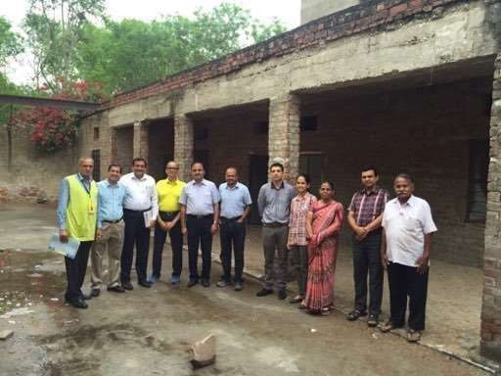
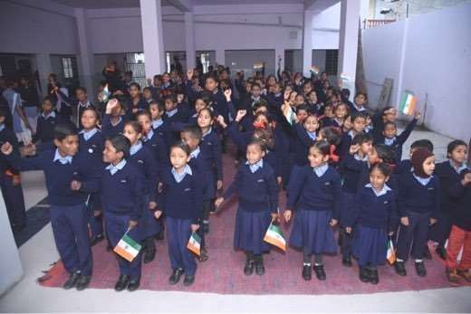
9. Government Upper Primary School, Santosh Nagar
Before Adoption
After Adoption

Slide 23
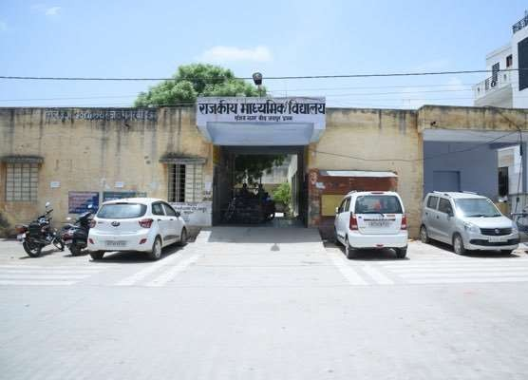
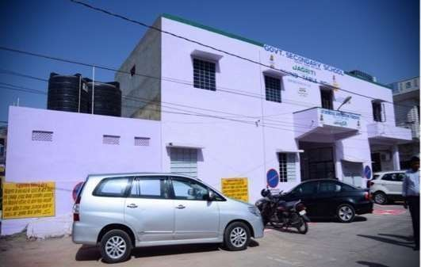
10. Government Secondary School, Sanjay Nagar
Before Adoption
After Adoption

Slide 24
11. Government Secondary School, Sushilpura
Before Adoption
After Adoption

Slide 25
12. Government Secondary School, Hathroi
Before Adoption
After Adoption

Slide 26
13. Government Senior Secondary School, Jaisinghpura
Before Adoption
After Adoption

Slide 27
14. Government Girls Senior Secondary School, C-Scheme
Before Adoption
After Adoption

Slide 28
14. Government Girls Senior Secondary School, C-Scheme

Slide 29
14. Government Girls Senior Secondary School, C-Scheme

Slide 30
14. Government Girls Senior Secondary School, C-Scheme

Slide 31
14. Government Girls Senior Secondary School, C-Scheme

Slide 32
15. Jagriti Balwadi School, Bhankrota

Slide 33
16. Government Upper Primary School, Arjunlal Sethi Nagar, Ajmer

Slide 34
17. Government Primary School, Kanadia, Ajmer

Slide 35
18. Government Primary School, Topdara, Ajmer

Slide 36
Initiatives of Equal Concentration
Skill Development for Women
We are also driven to empower underprivileged girls and women through skill development. We offer them market focused livelihood programs free of charge like stitching, gem cutting & beauty parlor courses.
Approximately 13000 girls and women have been trained so far who are now financially supporting their families.
Mobile Mortuary
We started a Mobile Mortuary, 24X7 free service, provided to the family of the deceased at their residence. The body can be kept for weeks, preventing decomposition. At present 12 such mortuaries are operated in Jaipur and Ajmer. On the up side, this machine has increased the rate of eye donation. Due to the device, the cornea is preserved and can be collected up to 24 hours. Mobile Mortuary services rendered to the houses of deceased to more than 8500 families free of cost
©copyrightjagriti2020

Slide 37
Other Initiatives of Equal Concentration
Blood Donation Camp
Sanskar Camp
Cancer Screening Camp
Tree Plantation
Jagriti Orations
©copyrightjagriti2020

Slide 38
Swachh Bharat

Slide 39
PPE Kits to our warriors, Doctors, Paramedical staff and Nurses

Slide 40
Packed food, Tea, Coffee, disposals, fruits, water bottles
to the Doctors, Paramedical staff and Nurses

Slide 41
Dry Ration at road side during the Pandemic

Slide 42
Dry Ration Distribution to the underprivileged families

Slide 43
Dry Ration Distribution to the underprivileged families

Slide 44
Oxygen Concentrator Bank
Before we could breath with relief, so called second wave of COVID-19 spread its dirty wings.
No door remained untouched
Amidst the pain and moaning all around and cry for Hospital Beds and for Oxygen.
इस दर्दभरे माहौल में ईश्वर ने हमारी प्रार्थना सुनी and we got 8 Oxygen Concentrators from our donors,

Slide 45
Medical Camps

Slide 46
Medical Camps

Slide 47
Continued teaching online with limited resources
Soon after the first lockdown was imposed on 17th March 2020, we got together and started the ONLINE classes for our students – Salute to our Principals & Teachers who worked untiringly in making it a great success with limited resources.

Slide 48
ONLINE classes for our students

Slide 49
ONLINE classes for our students

